Slide 1
Project Night terror
Evan Geissler
Notes:
**Randomly generate where texts are, items are, placements, etc. Core static, other stuff different.

Slide 2
Previous
1) Documentation
2) Testing (Main Focus)
3) AI, Items, Perks, etc.
4) General design (unexpected things, fix up things, etc. such as bugs or things not initially thought of)

Slide 3
Testing
Usability/User Testing
Boundary Testing
General Testing
Do things work
Do things look good during gameplay, etc.
Other Testing
Players getting stuck (ex. Falls into river, can’t get out)
Player movements
Player related things, etc.

Slide 4
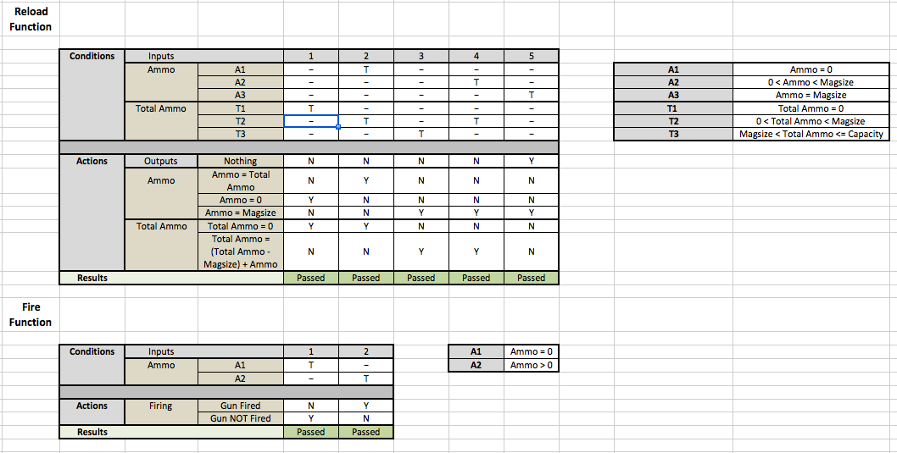
Testing Example

Slide 5
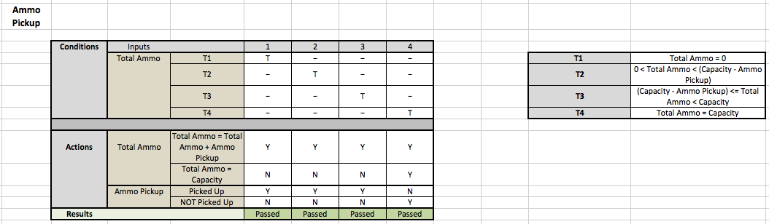
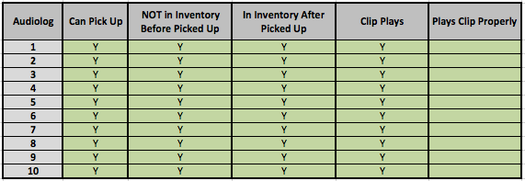
Testing Example

Slide 6
future
Heavily focused on:
Testing
Poster
AI
Documentation
Other focus on:
Audio
Saving/Loading
Finalizing levels, items, menus, etc.

Slide 7
Demo

